Slide 1


ICD 9 diagnosis codes
FROM GOOGLE TO ENCODERPRO

Slide 2
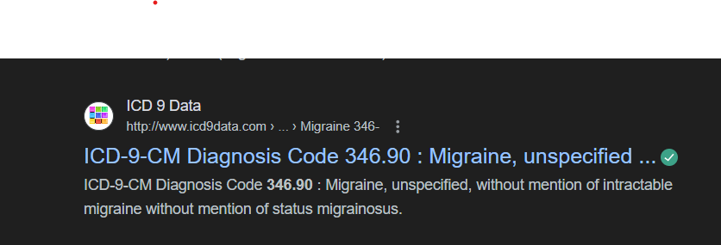
What we are using now for ICD 9 version diagnosis code search ?
We are currently using Google.hk for diagnosis code search . The website we are using as mentioned below:
For E.g:

Slide 3
Disadvantages of google search
We can not able to find accurate diagnosis codes.
Chances of errors are more it will effect BA.
More overly the current website which we are following , we can’t open it in deep.
While searching we are getting more results so difficult to choose the exact one.
May be in future we will loose our customer’s faith.
More time consuming.

Slide 4
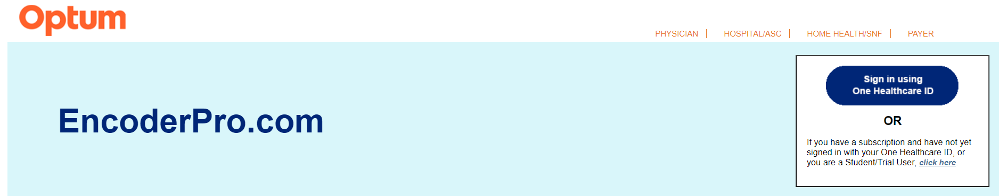
What is the solution ?
Here is the solution for our problem
We can use ‘Optum Encoder Pro’ for better diagnosis coding
Click Here www.endoderpro.com

Slide 5
Optum Encoder Pro Overview
EncoderPro.com is an online coding tool provided by Optum Coding.
It provides detailed information on ICD-9-CM and ICD-10-CM/PCS codes.
This version offers real-time code look-up capabilities.
Furthermore, it incorporates Optum and Medicare coding guidelines to ensure coding. accuracy, improve billing performance, and reduce rejected claims.
Real time code lookup, comprehensive code details, efficient search, less time consuming, regular updates of codes, vast library of codes etc. These are the advantages of this application.

Slide 6
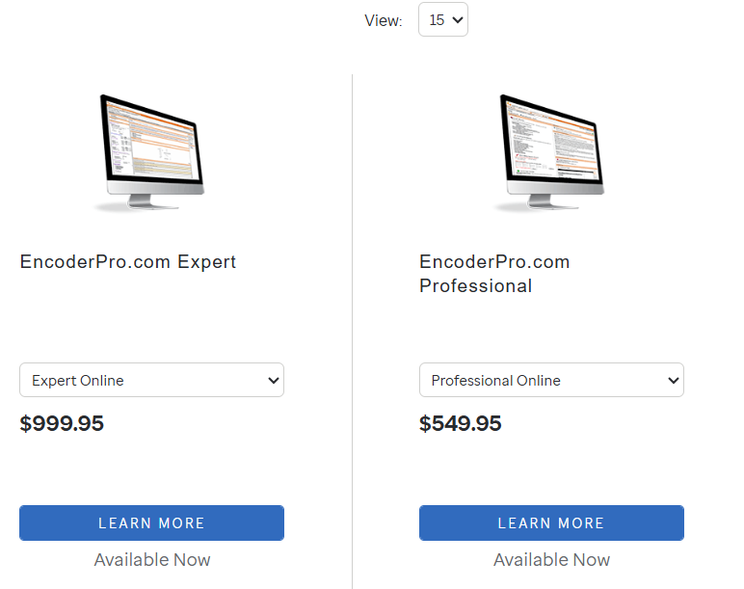
Current plans

Slide 7
Contact Information
Contact Us,
Reach us by phone
1-800-464-3649, option 1 Customer Service representatives are available Monday through Friday, 7 am –7 pm CST.
Send mail to customerassistance@optum.com
Optum 12921 S Vista Station Blvd, Ste 200 Draper, UT 84020
Send us an email
For general inquiries, please complete the form below. We will respond to your correspondence within one business day.

